Slide 1
Western Australia: Provider information session Webinar
Wednesday 18 November 2020, 10:00am to 1:00pm AWST

Slide 2
Agenda
Provider responsibilities (includes Q&A): Samantha Taylor, Registrar
Behaviour Support: Tracey Harkness, National Director – Behaviour Support
Complaints and Reportable Incidents: Robert Griew, Complaints Commissioner and Laura Dorahy, National Director – Complaints and Reportable Incidents
Panel Q&A on Behaviour Support and Reportable Incidents: Tracey Harkness, Robert Griew, Laura Dorahy
Local WA team introductions: Samantha Jenkinson, State Director

Slide 3
Provider responsibilities
Samantha Taylor PSM, Registrar

Slide 4
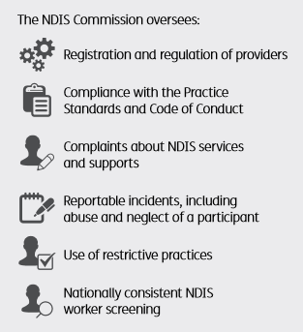
How do we work with providers?
We work with providers to improve the quality and safety of NDIS supports and services

Slide 5
NDIS Code of Conduct
Worker Orientation Module ‘Quality Safety and You’ www.ndiscommission.gov.au/trainingcourse

Slide 6
Who needs to be registered?
Providers must be registered with the NDIS Commission if you deliver one or more of the following:
Services and supports to NDIS participants who have their plan managed by the NDIA
Specialist activities: SDA and Behaviour Support
Implement restrictive practices as part of the supports and services to participants
Providers delivering supports to people under the Commonwealth Continuity of Support program
There are benefits to providers in being registered

Slide 7
What does registration involve?
There are three components to registration:
assesses the provider and its key personnel for suitability to participate in the NDIS market, and
Independent assessment (audit) of against relevant NDIS Practice Standards, then
sets conditions of registration depending on what services and supports you are registering to provide

Slide 8
Provider registration
Conditions of registration:
Compliance with Commonwealth, state and territory laws
NDIS Practice Standards
NDIS Code of Conduct
Complaints management and resolution requirements
Incident management and Reportable Incident requirements
Behaviour Support requirements (if applicable)
Worker screening.

Slide 9
What are the NDIS Practice Standards?
Requirements that set the standard of service you must deliver to be a registered NDIS provider
Benchmark for providers to assess performance and demonstrate high quality and safe supports for participants
Each Practice Standard is built from a high-level participant outcome, supported by quality indicators.

Slide 10
Practice Standards Audit – Verification
Baseline quality expectations of less complex supports and services for NDIS participants, usually with other regulatory oversight
Verification module includes:
Complaints management
Incident management
Risk management
Human resource management.
Plus:
General requirements including qualifications and experience

Slide 11
Practice Standards Audit – Certification
Baseline quality expectations of more complex supports and services for NDIS participants
Core module includes:
• Rights and Responsibilities
• Governance and Operational Management
• Provision of Supports, and
• Support Provision Environment.
Supplementary modules (for more complex supports):
• High intensity daily personal activities
• Specialist behaviour support
• Implementing behaviour support plans
• Early childhood supports
• Specialised support coordination
• Specialised disability accommodation.

Slide 12
Person centred supports
Standard Example:
Core Module: Rights and responsibilities
Person-centred supports
Individual values and beliefs respected
Privacy and dignity upheld
Independence and informed choice
[Free from] violence, abuse, neglect, exploitation and discrimination.
Outcome: Each participant accesses supports that promote, uphold and respect their legal and human rights and is enabled to exercise informed choice and control. The provision of supports promotes, upholds and respects individual rights to freedom of expression, self-determination and decision-making.
To achieve this outcome, the following quality indicators should be demonstrated:
Each participant's legal and human rights are understood and incorporated into everyday practice.
Communication with each participant about the provision of supports is responsive to their needs and is provided in the language, mode of communication and terms that the participant is most likely to understand.
Each participant is supported to engage with their family, friends and chosen community as directed by the participant.
12

Slide 13
Worker screening
New national worker screening system and database coming
It will replace existing arrangements and set a single, national standard for all workers
When in place, all registered NDIS providers must ensure
workers have a valid clearance
Until in place, existing arrangements continue to apply
Workers will be subject to ongoing monitoring nationally.

Slide 14
What happens when things don’t go well
The NDIS Commission will respond appropriately to issues that arise, and identify opportunities to prevent them occurring again.
Early resolution
Conciliation
Compliance action

Slide 15
How the NDIS Commission will support you
We are working with states and territories to build local relationships, and with the NDIA
Providers have received information from the NDIA on transition arrangements
We’ve sent you a series of resources/information
Visit our updated website
Contact us if you can’t find what you need.

Slide 16
Questions about provider responsibilities?

Slide 17
Behaviour Support
Tracey Harkness, National Director – Behaviour Support

Slide 18
Behaviour Support: Our role
Raising the bar of positive behaviour support that should focus on:
Safeguarding the dignity of the person and improving their quality of life
Contemporary evidence-based practice
Constructively reducing behaviours that may lead to harm of self or others
Work towards the reduction and elimination of restrictive practices

Slide 19
How we will reduce/eliminate restrictive practices
Building the capacity and assessing suitability of Behaviour Support Practitioners
Developing policy and guidance materials, education and advice
Monitoring/analysing use of restrictive practices
Assisting states and territories in developing nationally consistent restrictive practice definitions and principles for authorisation.

Slide 20
Regulated restrictive practices
Restrictive practice: Any practice or intervention that has the effect of restricting the rights or freedom of movement of a person with disability (NDIS Act 2013 s9)
Regulated restrictive practices [NDIS (Restrictive Practices and Behaviour Support) Rules 2018]:
Seclusion
Chemical restraint
Mechanical restraint
Physical restraint
Environmental restraint.

Slide 21
Regulated restrictive practices
Regulated restrictive practices can only be used in the context of:
Reducing the risk of harm to the self or others
Only being used as a last resort and the least restrictive response available
Being proportionate to the potential harm to self or others
Being used for the shortest possible time
The NDIS participant being given opportunities to develop new skills that have the potential to avoid the need for a restrictive practice.
Clearly being identified in a Behaviour Support Plan
Authorisation (however described) by the State/Territory where required

Slide 22
Behaviour Support: Provider requirements
Providers must be registered for specialist behaviour support (or be a registered sole trader)
Specialist Behaviour Support Providers must engage an NDIS behaviour support practitioner to deliver services
Practitioners must be considered suitable as an NDIS behaviour support practitioner to undertake assessments and develop behaviour support plans
Positive Behaviour Support Capability Framework
“provisional suitability”.

Slide 23
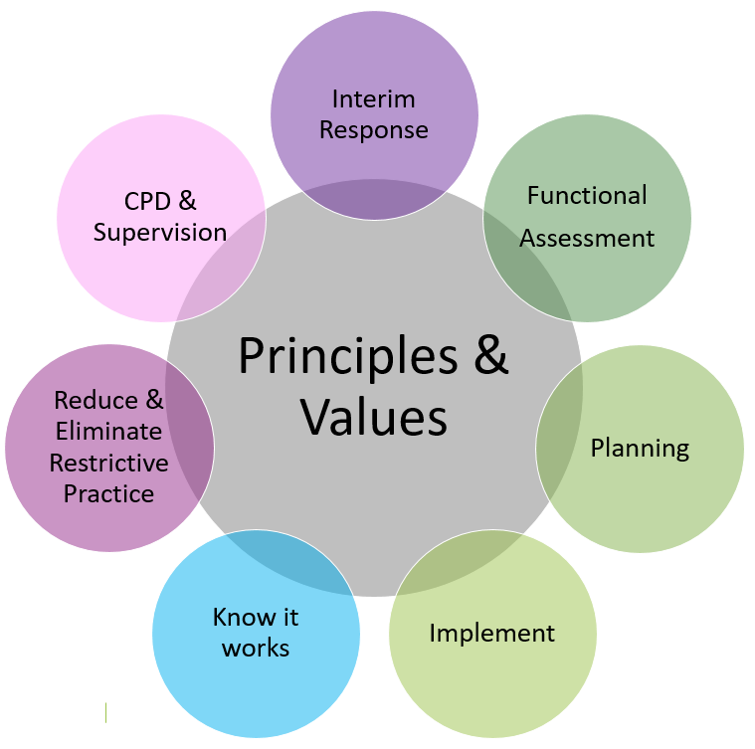
Assessment Resource Toolkit for the PBS Capability Framework
STEP 1
Practitioner self-assessment
Supervisor or provider validation
STEP 2
Practitioner and supervisor evidence
STEP 3
NDIS Commission
Verifies evidence
Determines suitability

Slide 24
Developing a behaviour support plan
For plans written after 1 December 2020 that include regulated restrictive practices, the NDIS behaviour support practitioner must develop:
An interim Behaviour Support Plan within 1 month
A comprehensive Behaviour Support Plan within 6 months, including a functional behaviour assessment
Interim and comprehensive behaviour support plans must be lodged with the NDIS Commission.

Slide 25
Implementing provider requirements
Providers must:
Keep records on the use of restrictive practices
Report monthly to NDIS Commission on the use of regulated restrictive practices
Obtain authorisation using existing state or territory legislation
Comply with reportable incident requirements if using unauthorised restrictive practices
Engage an NDIS behaviour support practitioner to develop behaviour support plans
Work with a NDIS Behaviour Support practitioner to implement positive behaviour support strategies and monitor outcomes for the person with disability
Support staff to receive appropriate training.
Notes:
At end of this slide, explain that there will be time for questions after the Complaints and Reportable Incidents presentation.

Slide 26
Complaints and Reportable Incidents
Robert Griew, Complaints Commissioner
Laura Dorahy, National Director – Complaints and Reportable Incidents

Slide 27
Complaints

Slide 28
Complaints
All providers are expected to act fairly on concerns about matters that may impact the quality and safety of services and supports.
Every registered NDIS provider must have a complaints management and resolution system.
The NDIS Commission handles complaints about NDIS providers.
All complaints are taken seriously and assessed
We seek to resolve complaints quickly, fairly and with as little formality as the issues permit
Complaints and feedback are an opportunity to improve services.

Slide 29
Who can make a complaint
Anyone can raise a complaint about the provision of supports and services by an NDIS provider, including:
a person with disability who is receiving, or is eligible to receive, supports or services from an NDIS provider
a worker employed or otherwise engaged by an NDIS provider (including volunteers)
friends or family of a person with disability
an advocate, guardian or any other person.

Slide 30
Complaints we action
The NDIS Commission can take complaints about NDIS supports and services, including:
whether they have been provided in a safe and respectful way
whether they have been delivered to an appropriate standard
how an NDIS provider has dealt with a complaint about services or supports provided to an NDIS participant
how an NDIS provider has dealt with an advocate or carer of an NDIS participant.

Slide 31
Complaints others may action
Other bodies are responsible for taking complaints for matters such as:
actions taken by the National Disability Insurance Agency (NDIA), including decisions about eligibility, funding or a participant’s plan
services or supports provided by an organisation which is not an NDIS provider (for example, health, education or transport services)
decisions of courts, tribunals or coroners.
Complaints about the NDIA can be made to the NDIA or to the Commonwealth Ombudsman.
We can help connect a complainant with the right organisation.

Slide 32
Complaints process
We will assess the issues raised in each complaint to determine how best to deal with it.
The process may include:
speaking with the complainant and the provider
seeking the views of people with disability affected by the issues raised
educating a provider about their obligations
facilitating meetings or offering conciliation
asking for information and explanations
requiring providers to take specific action
In some cases, we may investigate or take compliance action

Slide 33
Reportable Incidents

Slide 34
Reportable Incidents
All registered providers must have an incident management system in place to records and manage incidents
Providers are required to notify us of reportable incidents that occur in connection with the delivery of NDIS supports and services
This does not replace existing obligations to report suspected crimes to the police and other relevant authorities.
www.ndiscommission.gov.au/providers/reportable-incidents

Slide 35
What is a Reportable Incident?
A serious incident or allegation which results in harm to an NDIS participant and occurs in connection with NDIS supports and services, including:
the death of a person with a disability
serious injury of a person with a disability
abuse or neglect of a person with a disability
unlawful sexual or physical contact with, or assault of, a person with a disability
sexual misconduct committed against, or in the presence of, a person with a disability, including grooming of a person with a disability for sexual activity
the unauthorised use of a restrictive practice in relation to a person with a disability

Slide 36
Timeframe to report incidents
Most Reportable Incidents must be notified to us within 24 hours of a provider’s key personnel being made aware of it.
A more detailed report about the incident and actions taken in response to it must be provided within 5 business days.
The unauthorised use of restrictive practice must be notified to us within 5 business days of a provider’s key personnel being made aware of it.
If there is harm to a participant, it must be reported within 24 hours.

Slide 37
Action we can take
If a Reportable Incident raises a serious compliance issue, we have powers to take action, which may include:
requiring the provider to undertake specified remedial action
carrying out an internal investigation about the incident
engaging an independent expert to investigate and report on the incident
give information to police or refer to another body e.g. child protection authorities.
Registered providers must make their records available to auditors as part of their quality assurance process, and contribute to our investigations relating to incidents.

Slide 38
How to report an incident
Use the NDIS Commission Portal ‘My Reportable Incidents’ page to notify and manage all reportable incidents.
‘Authorised Reportable Incidents Approver’ is the person you want to have the authority to review and be responsible for submission to the NDIS Commission. This could be the person specified in your incident management system who is responsible for reporting incidents to the NDIS Commission.
‘Authorised Reportable Incidents Notifier’ is a supporting team member who can assist the ‘Authorised Reportable Incidents Approver’ to collate and report the required information. The authorised ‘Notifier’ will have the ability to create new Reportable Incident notifications to be saved as a draft for review and submission by the authorised ‘Approver’.

Slide 39
Questions about - behaviour support - complaints or - reportable incidents?

Slide 40
Western Australia team
Samantha Jenkinson, State Director

Slide 41
Further information
For more information visit:
www.ndiscommission.gov.au
Or contact: 1800 035 544
This is a free call from landlines
Follow us:
LinkedIn: www.linkedin.com/company/ndiscommisson
Facebook: www.facebook.com/NDISCommission

